Slide 1
Job readiness in AI and Data Science
Aniket Chhabra (Lead Data Scientist - PayPal)

Slide 2
Agenda Table
Objective
What is Data Science
Roles available in the market
Education and Background
Resume and Profile building on all the platforms
Projects we need to showcase
Findings the jobs (factors to consider)
Where to learn the topics or continuous learning
The future or New Arena
Q&A
Notes:
https://towardsdatascience.com/preparing-your-data-science-resume-portfolio-22af6bada8b9
https://towardsdatascience.com/5-things-to-consider-in-a-data-science-masters-degree-48a84028959d
https://nyudatascience.medium.com/a-message-from-master-in-the-making-sree-govindaprasad-3f282c5ff297
https://towardsdatascience.com/was-it-worth-studying-a-data-science-masters-c469e5b3e020

Slide 3
Objective
Machine Learning Scientist/Artificial Intelligence are one of the most coveted job profiles of the current times. With a significant increase in overlap between IT/Technology and Data Science (especially Programming and Data Science Models) has widened the scope resulting in plethora of opportunities in the market. In our today's session, I am going to introduce you to the AI/ML career building nuances which will help transform you into tomorrow's professionals. We will talk about the necessary background required, an understanding of different technologies/frameworks, resume highlights followed by available jobs in the market.
Notes:
https://towardsdatascience.com/preparing-your-data-science-resume-portfolio-22af6bada8b9
https://towardsdatascience.com/5-things-to-consider-in-a-data-science-masters-degree-48a84028959d
https://nyudatascience.medium.com/a-message-from-master-in-the-making-sree-govindaprasad-3f282c5ff297
https://towardsdatascience.com/was-it-worth-studying-a-data-science-masters-c469e5b3e020

Slide 4
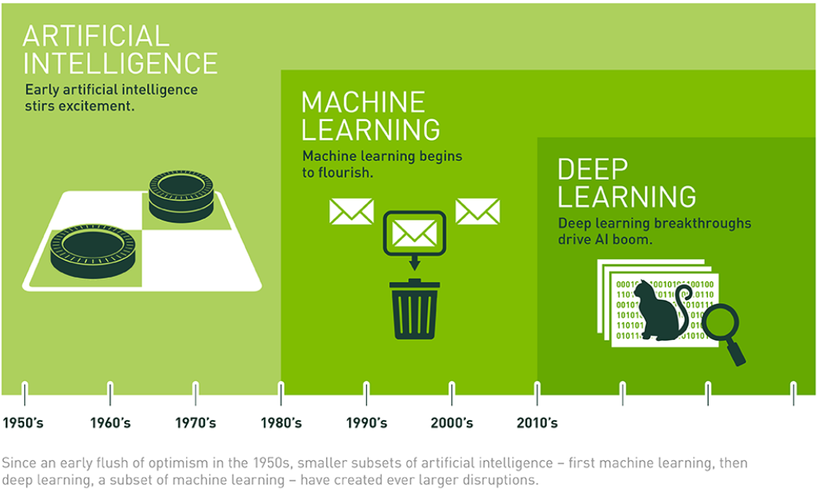
Introduction to Data Science
Notes:
https://towardsdatascience.com/preparing-your-data-science-resume-portfolio-22af6bada8b9
https://towardsdatascience.com/5-things-to-consider-in-a-data-science-masters-degree-48a84028959d
https://nyudatascience.medium.com/a-message-from-master-in-the-making-sree-govindaprasad-3f282c5ff297
https://towardsdatascience.com/was-it-worth-studying-a-data-science-masters-c469e5b3e020

Slide 5
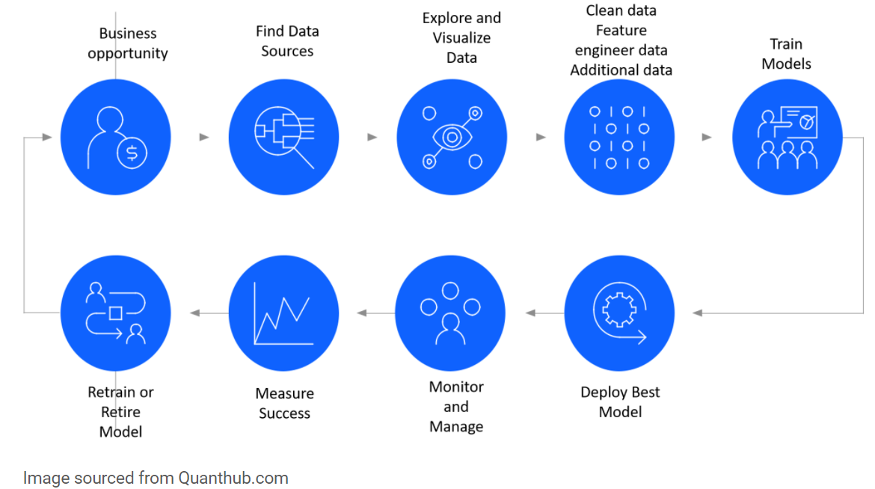
Introduction to Data Science
Data scientist most valuable skill is to use data to provide business value. It could be providing relevant insights to solve business challenges or reach business objectives or using machine learning models for better business decision making etc
Notes:
https://towardsdatascience.com/preparing-your-data-science-resume-portfolio-22af6bada8b9
https://towardsdatascience.com/5-things-to-consider-in-a-data-science-masters-degree-48a84028959d
https://nyudatascience.medium.com/a-message-from-master-in-the-making-sree-govindaprasad-3f282c5ff297
https://towardsdatascience.com/was-it-worth-studying-a-data-science-masters-c469e5b3e020

Slide 6



Prerequisites
Key skills required to learn Data Science and be in the industry
Mathematics
Statistics
To understand the technicality behind the ML and DL models
Topics like – Linear Algebra, Calculus, Set theory, discrete theory
To understand the basis of Data Science and helps in interpretation
Topics like – Probability Theory, Basic Statistics, Hypothesis Testing etc.
Programming
Analytical Thinking
To code behind the data and ML models
Tools like – Python/R/SAS, SQL, Cloud platforms
Problem solving approach
Creating/Analytical thinking to formulate solution of the business probelm
Education
Higher Education
Undergraduation – Engineering, Economics, Statistics, maths are more prevalent
For others + Data Science professional certificate/diploma
Doing Masters in Data Science or Compue vision
Post getting the experience
Notes:
https://towardsdatascience.com/preparing-your-data-science-resume-portfolio-22af6bada8b9
https://towardsdatascience.com/5-things-to-consider-in-a-data-science-masters-degree-48a84028959d
https://nyudatascience.medium.com/a-message-from-master-in-the-making-sree-govindaprasad-3f282c5ff297
https://towardsdatascience.com/was-it-worth-studying-a-data-science-masters-c469e5b3e020

Slide 7
Roles and Opportunity in Market
The role of Data Scientist is to build -
Data Mining
Predictive Modeling & Insights
Data Driven solutions towards business goals
Skills required -
Programming - Python/SQL/R
Traditional Models/ML/DL(in few cases)
Cloud - Started gaining traction
Roles available in the market - To be added
The role of BA/DS is -
Data driven business solutions/framework
Data Insights
Consulting skills
Skills required -
Programming - SQL/Python/R
ML Models (not in the all the cases)
Data Scientist
Common skills required - Problem solving
Result orientation
Client engagement
Business acumen
Agile (more common these days)
Business Analyst/Decision Scientist
The role of ML Engineer is -
Data Management Tools - DBMS
Data Pipelines/Cubes
ML Deployment
Skills required -
Programming - Python/SQL/R
ML Models (not in the all the case
Cloud - Being utilized
ML/Data Engineer
Notes:
https://medium.com/@jasonkgoodman/advice-on-applying-to-data-science-jobs-6e62b25518e5
https://m.signalvnoise.com/practical-skills-that-practical-data-scientists-need/

Slide 8
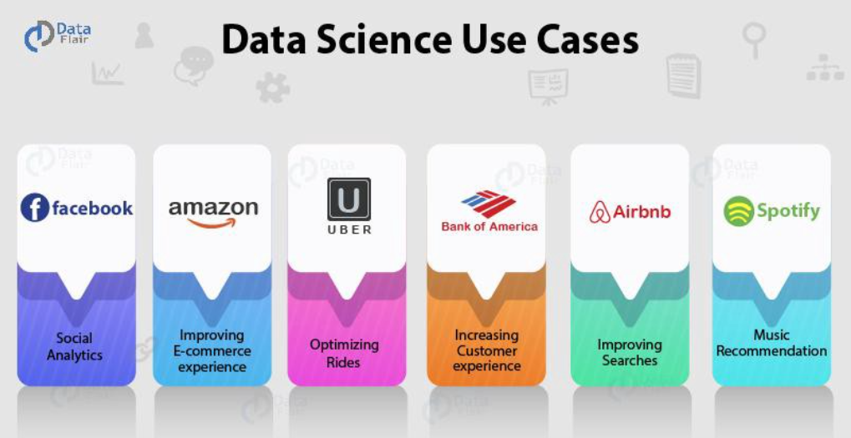
Industries Leveraging Data Science
Data scientist most valuable skill is to use data to provide business value. It could be providing relevant insights to solve business challenges or reach business objectives or using machine learning models for better business decision making etc
Notes:
https://towardsdatascience.com/preparing-your-data-science-resume-portfolio-22af6bada8b9
https://towardsdatascience.com/5-things-to-consider-in-a-data-science-masters-degree-48a84028959d
https://nyudatascience.medium.com/a-message-from-master-in-the-making-sree-govindaprasad-3f282c5ff297
https://towardsdatascience.com/was-it-worth-studying-a-data-science-masters-c469e5b3e020

Slide 9
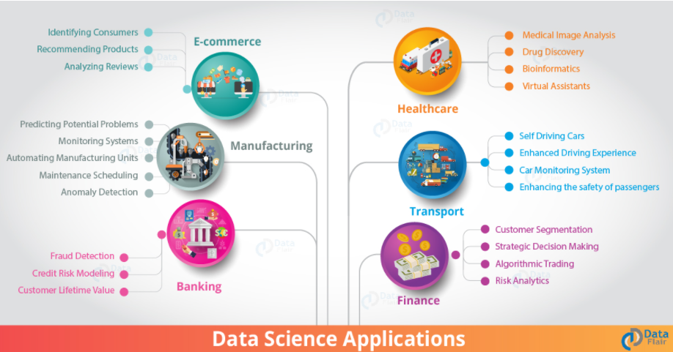
Industries Leveraging Data Science
Data scientist most valuable skill is to use data to provide business value. It could be providing relevant insights to solve business challenges or reach business objectives or using machine learning models for better business decision making etc
Notes:
https://towardsdatascience.com/preparing-your-data-science-resume-portfolio-22af6bada8b9
https://towardsdatascience.com/5-things-to-consider-in-a-data-science-masters-degree-48a84028959d
https://nyudatascience.medium.com/a-message-from-master-in-the-making-sree-govindaprasad-3f282c5ff297
https://towardsdatascience.com/was-it-worth-studying-a-data-science-masters-c469e5b3e020

Slide 10
Prequistes
Why under gradation is important? - helps in building strong and critical thinking skills, researching skills and analysis power
Which stream is important - Economics, Statistics, Mathematics/Engineering are common and most prevalent.
What about other Educational background?
Masters/PHDs in Data Science or Machine learning -
Technical Background - B-Tech/Economics/Maths & Statistics Background – Marks matter
Programming - Where possible, do showcase any codes written, especially if the codes are written for data science projects.
JD Requirements
Higher education – MS and Phds
Notes:
https://towardsdatascience.com/preparing-your-data-science-resume-portfolio-22af6bada8b9
https://towardsdatascience.com/5-things-to-consider-in-a-data-science-masters-degree-48a84028959d
https://nyudatascience.medium.com/a-message-from-master-in-the-making-sree-govindaprasad-3f282c5ff297
https://towardsdatascience.com/was-it-worth-studying-a-data-science-masters-c469e5b3e020

Slide 11
Resume and Profile Building & Resume Selectton
Resume + Linkedin + Github + Kaggle + Blogs/articles/videos etc.
You want to find your first job, but you don’t yet have any work experience, which, ironically, is often listed in requirements for Intern and Junior positions.
Profile Links – Kaggle/Github/Linkedin
Projects -
Do have keywords (such as the machine learning models used, the model training process etc) used to explain the project but be prepared to explain those keywords especially when it is a technical interview.
But only mentioning ML techniques like
Organize your projects
They demonstrate that you can apply data science techniques to real problems that you encounter every day
They allow you to “show” that you understand a concept rather than “tell”
To make your contribution and achievements obvious, try to organize all your projects by answer the following four questions:
Why you did it? What problem did you want to solve? Show what the end goal of the project was.
What did you do? Explain how did you approach the problem. If you can show code, paper, blog post, or a presentation at a conference — do it!
How you did it? Present tools which you’ve used. It would be easier for HR to match them with tools in requirements. List only tools you’ve actually used. During the interview, you may be asked how you’ve used them.
What did you achieve? Show quantitative results of your work in technical and business metrics. Write only actual results. Do not present results better than they are.
Kind of Projects – Regession, Classification,
Personality details - I am an avid reader, so I usually include 5 of the best books I have read in the past few months.
Notes:
https://towardsdatascience.com/how-to-write-a-data-science-resume-3cc7de25b149
https://towardsdatascience.com/the-projects-you-should-do-to-get-a-data-science-job-457d3fe7d660

Slide 12
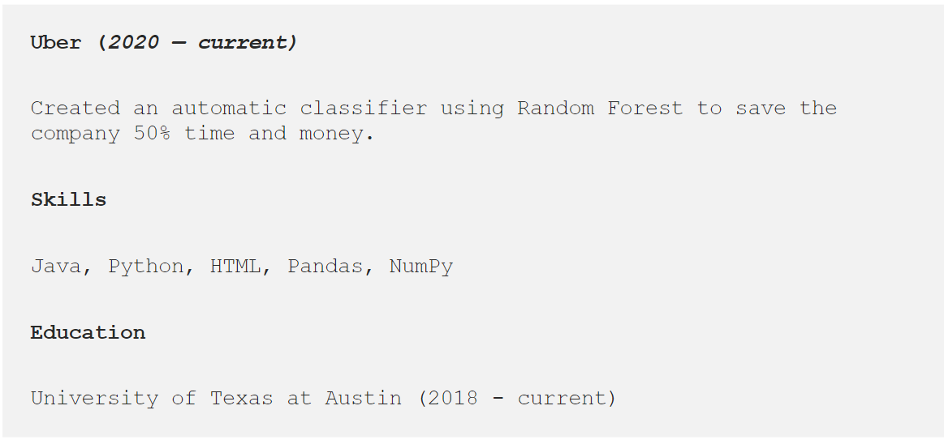
Data Science Projects
What Projects to add + how to showcase your existing projects
Automatically classified products (1) by developing an XGBoost algorithm (2) that reduced manual grouping by 60% (3), ultimately saving 2X of our operating costs (3).
Write Head matching the job you’re looking for -
Notes:
https://towardsdatascience.com/4-improvements-for-your-data-science-resume-1d1b087619f1
https://medium.com/@CLouvi/how-can-i-improve-my-linkedin-profile-to-get-a-data-scientist-job-49057854ad4a
https://medium.com/@cakmakmuhammet12/how-to-optimize-linkedin-profile-and-get-more-attention-624cdbd38c13

Slide 13
Finding Jobs: Factors to Consider + Interview Preparation
How to prepare for interview + storytelling
Technical Background - B-Tech/Economics
JD Requirements
Small vs. Large Companies
Sources for Job Postings
The Cadence of Interviews
SQL
Pick R or Python
Learn your basic data manipulation functions and presentation methods really well
Prepare accordingly to the JD
Job Offer stage
Thus, the only way to understand whether the job you’re applying for matches your desired level of sophistication is to read the requirements carefully, and potentially to talk to people at the company if possible.
You might also ask whether there is mentorship available in the areas that interest you, and whether you can occasionally work on projects that move in you closer to the type of work you’re hoping to do.
Ask for refrrels
Notes:
https://medium.com/@jasonkgoodman/advice-on-applying-to-data-science-jobs-6e62b25518e5
https://medium.com/@rchang/my-two-year-journey-as-a-data-scientist-at-twitter-f0c13298aee6
https://m.signalvnoise.com/infrastructure-worth-investing-in/

Slide 14
Automation/MLOps – The new arena
The tough reality part
Do you know? in today’s time, these “automation tasks are being automated using another automation strategy?” The whole data science pipeline is being automated using a single tool.
In 2019, data scientists used to spent days in data gathering, data cleaning, feature selection, but now we have many tools in the market that can do these tasks in a few minutes.
But, today, we have tools like H2O, PyCaret, and many other cloud providers who can do the same model selection on the same data using the combination of other 30–50 machine learning libraries to give you the best machine learning algorithms for your data with least error
And these tools are doing well than us because where we are using limited machine learning algorithm knowledge
When we talk about deep learning, that is famous for handling unstructured data. And, 95% time, we work with images and test data here. Object detection, image segmentation, building chatbots, sentiment analysis, document similarity are the famous use cases.
Notes:
https://towardsdatascience.com/there-will-be-a-shortage-of-data-science-jobs-in-the-next-5-years-9f783737ed23

Slide 15
Where to learn the topics
What we currently lack today
Every expert was once a beginner — Helen Hayes
Reading Widely –
Papers – Arxiv
Blogs – Medium, Kaggle, GL
Videos – Great learning academy
Courses – GL full
Networking/seminars/sessions/conferences
GL covering Multiple courses – to be added
Notes:
https://towardsdatascience.com/the-data-science-thought-process-df386ee7930a

Slide 16
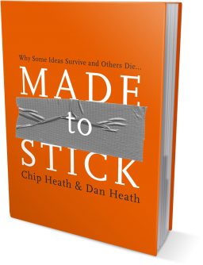
Selling your idea
Created in partnership with Chip and Dan Heath, authors of the bestselling book Made To Stick, this template advises users on how to build and deliver a memorable presentation of a new product, service, or idea.

Slide 17


1. Intro
Choose one approach to grab the audience’s attention right from the start: unexpected, emotional, or simple.
Unexpected Highlight what’s new, unusual, or surprising.
Emotional Give people a reason to care.
Simple Provide a simple unifying message for what is to come

Slide 18
How many languages do you need to know to communicate with the rest of the world?
Tip
In this example, we’re leading off with something unexpected.
While the audience is trying to come up with a number, we’ll surprise them with the next slide.

Slide 19
Just one! Your own.
(With a little help from your smart phone)
Tip
Remember. If something sounds like common sense, people will ignore it.
Highlight what is unexpected about your topic.

Slide 20

The Google Translate app can repeat anything you say in up to NINETY LANGUAGES from German and Japanese to Czech and Zulu
Tip
Don’t wait till the end of the presentation to give the bottom line.
Reveal your product or idea (in this case a translation app) up front.

Slide 21
2. Examples
By the end of this section, your audience should be able to visualize:
What What is the pain you cure with your solution?
Who Show them a specific person who would benefit from your solution.

Slide 22

Meet Alberto.
He recently moved from Spain to a small town in Northern Ireland.
He loved soccer, but feared he had no way to talk to a coach or teammates.
Tip
Tell the audience about the problem through a story, ideally a person.

Slide 23

Meet Marcos.
He recently opened a camera shop near the Louvre in Paris.
Visitors to his store, mostly tourists, speak many different languages making anything beyond a simple transaction a challenge.
Tip
If one example isn’t sufficient to help people understand the breadth of your idea, pick a couple of examples.
Story for illustration purposes only

Slide 24

A translation barrier left Alberto feeling lonely and hurt Marco’s business.
Tip
Ideally, speak of people in very different situations, but where each could benefit from your solution.

Slide 25

Then, Marcos discovered Google Translate
He has his visiting customers speak their camera issues into the app.
He’s able to give them a friendly, personalized experience by understanding exactly what they need.

Slide 26

A simple gesture
Coaches Gary and Glen knew no Spanish.
They used Google Translate to invite Alberto to join in... “Do you want to play?”... “Can you defend the left side?”
Tip
Show how your solution helps the person in the story reach his or her goals.

Slide 27

From outsider to star
Alberto scored 30 goals in 21 games. He is now being scouted by several professional clubs in the Premier League. And he’s a favorite of the other boys on the team.
See a short video on Alberto’s story
Tip
Stories become more credible when they use concrete details such as the specific complex moves Alberto learned through Translate and his 30 goals in 21 games performance stats.

Slide 28
3. Examples
People need to understand how rare or frequent your examples are.
Pick 1 or 2 statistics and make them as concrete as possible. Stats are generally not sticky, but here are a few tactics:
Relate Deliver data within the context of a story you’ve already told
Compare Make big numbers digestible by putting them in the context of something familiar

Slide 29
It’s no surprise Marcos uses Google Translate in his shop regularly.
There are 23 officially recognized languages in the EU.
Tip
Don’t let data stand alone. Always relate it back to a story you’ve already told, in this case, Marco’s shop.
Source: theguardian.com

Slide 30


More than 50 million Americans travelled abroad in 2015
THAT’S MORE THAN THE POPULATION OF
CALIFORNIA AND TEXAS COMBINED
Tip
When a number is too large or too small to easily comprehend, clarify it with a comparison to something familiar.
Source: travel.trade.gov

Slide 31
4. Closing
Build confidence around your product or idea by including at least one of the these slides:
Milestones What has been accomplished and what might be left to tackle?
Testimonials Who supports your idea (or doesn’t)?
What’s next? How can the audience get involved or find out more?

Slide 32
Milestones
October 2014
October 2015
August 2015
November 2015
Translate web pages with Chrome extension
Translate text within an app
2014 |  |  |  | 2015
Translate conversations through your Android watch
Translate written text from English or German to Arabic with the click of a camera

Slide 33
What people are saying
With this app, I’m confident to plan a trip to rural Vietnam
Wendy Writer, CA
Visual translation feels like magic
Ronny Reader, NYC
Translate has officially inspired me to learn French
Abby Author, NYC
Quotes for illustration purposes only

Slide 34

Know a 2nd language? Make Google Translate even better by joining the community.
Tip
Inspire your audience to act on the information they just learned.
Depending on your idea, this can be anything from downloading an app to joining an organization.

Slide 35
Good luck!
We hope you’ll use these tips to go out and deliver a memorable pitch for your product or service!
For more (free) presentation tips relevant to other types of messages, go to heathbrothers.com/presentations
For more about making your ideas stick with others, check out our book!

